Slide 1


Analyzing Cricket
Daniel Valdes, JACK BITCON, Thomas Byrne, and Peter Sheldon

Slide 2
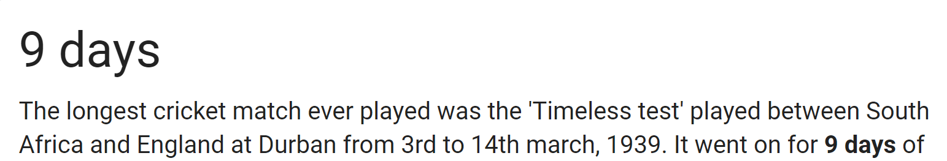
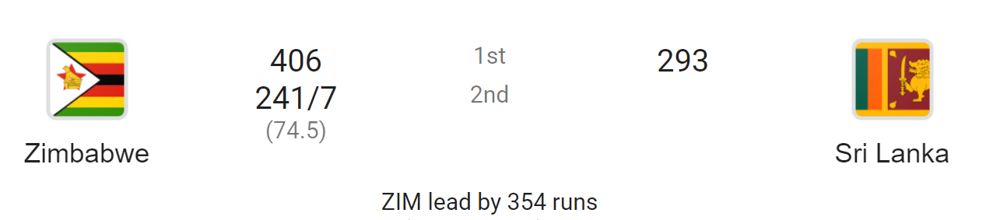
What you need to know
Cricket is second only behind soccer as the worlds most popular sport. It is a sport in which the matches can run on for days, and the scores reach into the hundreds. To understand what we are analyzing, there are a few key rules and terms to keep in mind.

Slide 3
Cont.
Batsman – like a batter in baseball. We are analyzing different aspects of what makes a batsman and who the all-time greats are.
Bowler – similar to a pitcher in baseball, the bowler “bowls” the ball straight-armed to the batsman. The bowler generally throws around 85-95 mph and can put varying levels of spin on the ball.
Not-outs – when a batsman’s team scores so many runs in one in one inning, they chose to rotate batsman before he is out.
Half-Century – 50 runs
Century – 100 runs

Slide 4
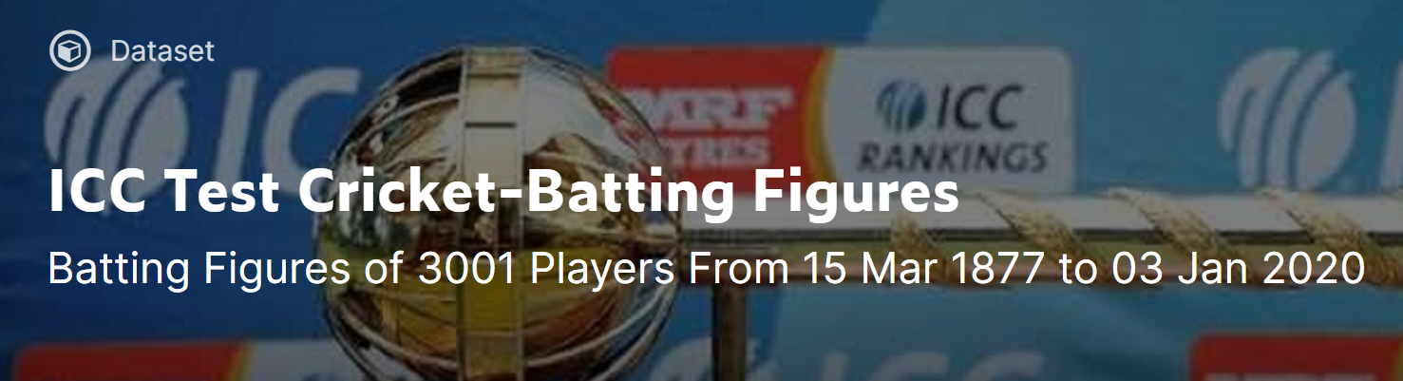
Dataset
Our dataset contained batting information for over 3000 players. From the excel file we dropped multiple columns and removed non-text characters from text columns in the document.

Slide 5
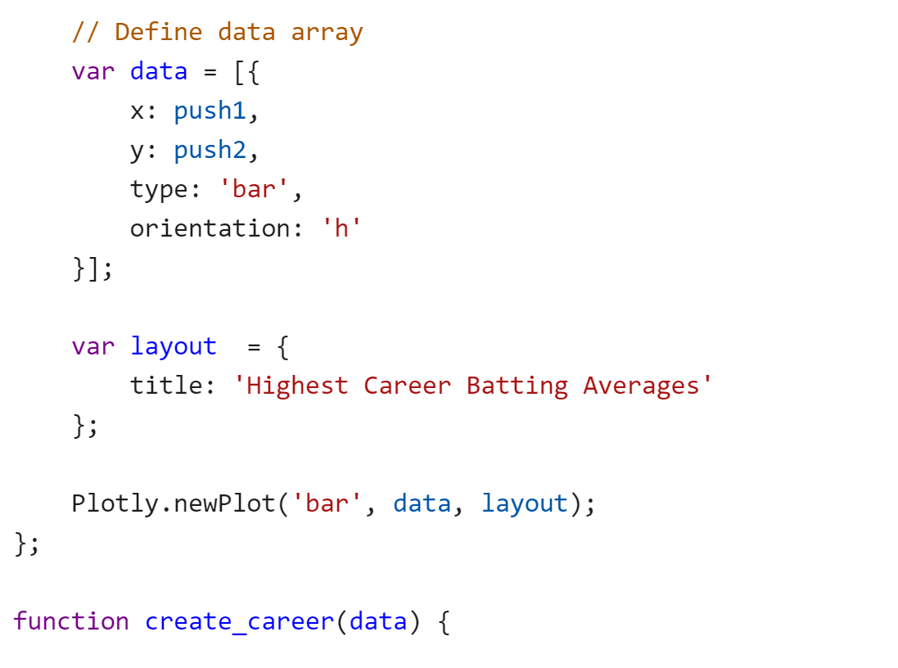
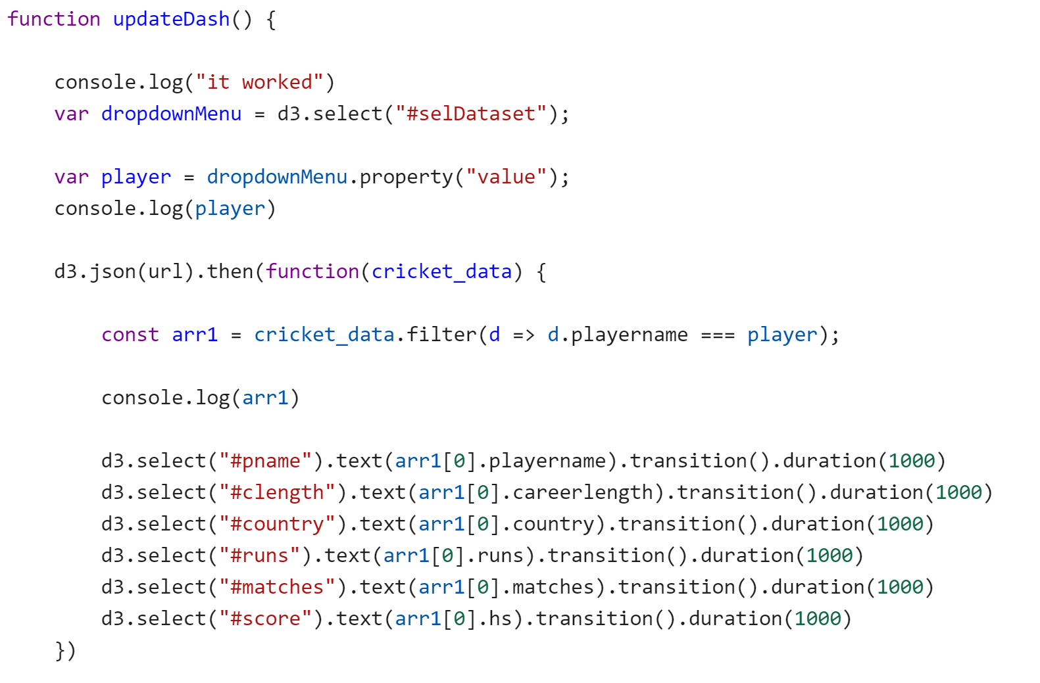
Analysis
Determining the best players to have ever played the sport based on batting average, hit percentage, and runs scored.

Slide 6
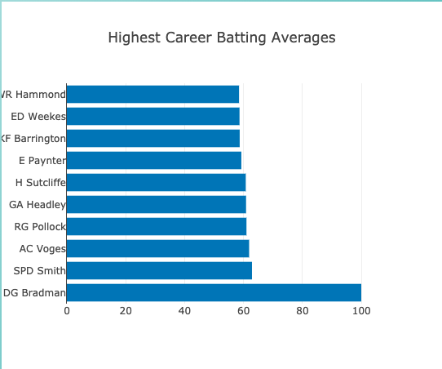
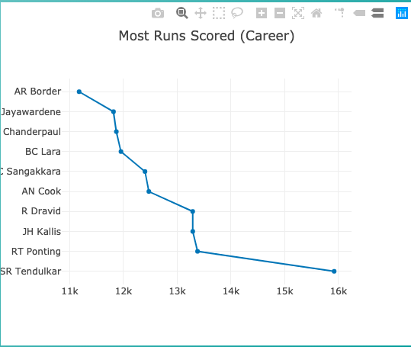
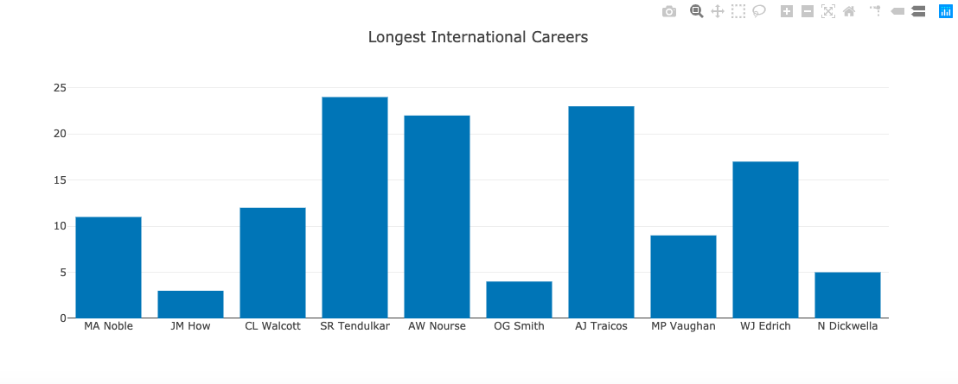
Graphics
Using plotly and D3 to generate functional graphics for our dashboard

Slide 7
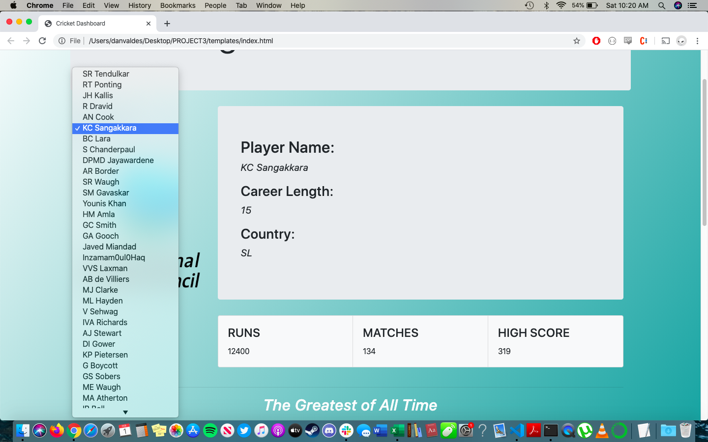
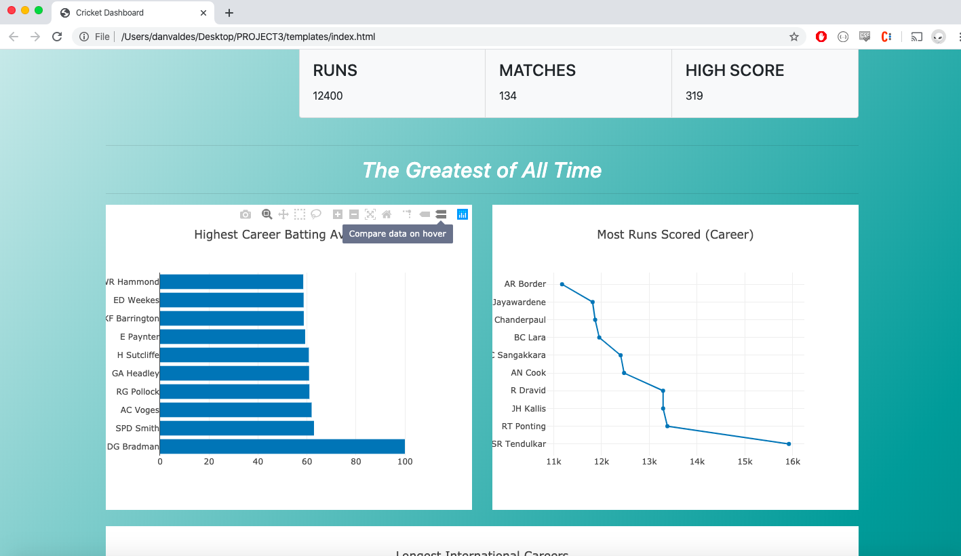
Functionality

Slide 8
Conclusion

